Slide 1



ATTACK
CYBER SECURITY

Slide 2
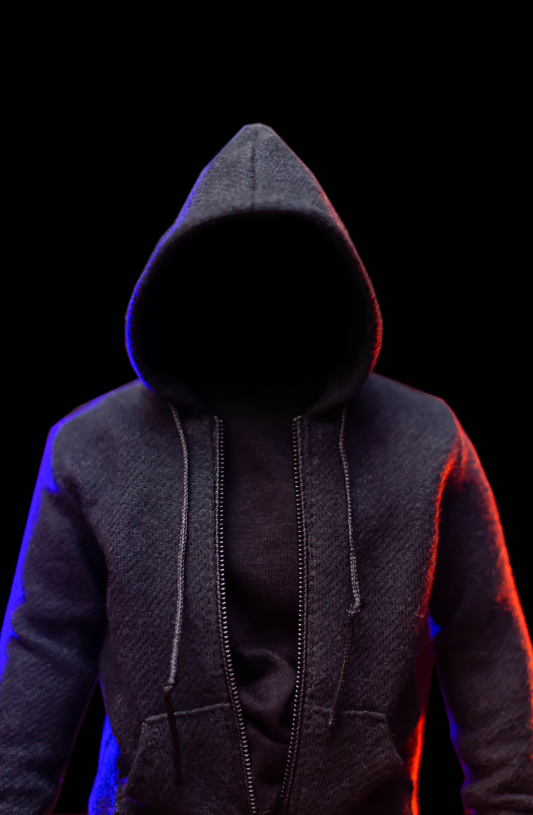

INTRODUCTION
In this presentation, our team delved into offensive tactics. Our team practiced some attacks, including MITRE ATT&CK analysis and red team exercises. Leveraging platforms like Windows Server 2022 and Kali Linux, we simulated real-world attacks and developed custom scripts. We also used the DVWA to run script attacks. From cookie stealing to navigation frameworks, we explored adversary techniques. Today, we present insights.

Slide 3

USED RESOURCES
All these were made available from the provided Files. Or other available internet resources
ORACLE VM VIRTUAL BOX
01
02
KALI LINUX
MS2 metasploitable
03
04
WIN2022

Slide 4
APPROACH
As instructed, we ran attack to conduct RED TEAM EXERCISES
01
We ran scripts on DVWA and also made a script of our own to further bost the learning outcome
02

Slide 5
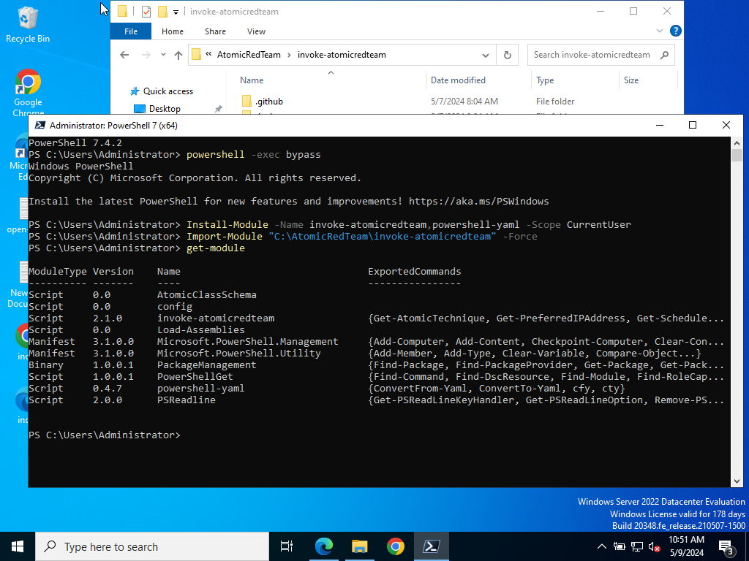
ATOMIC RED TEAM
T1016
We downloaded the Attack Modules from a github repository owned by a CS Team, “Red Cranary”
As per instructed installed the Modules on the Device by using powershell 7 and imported the module.
We used powershell -exec bypass command to execute code for demonstrating having no admin level access.
WIN2022

Slide 6
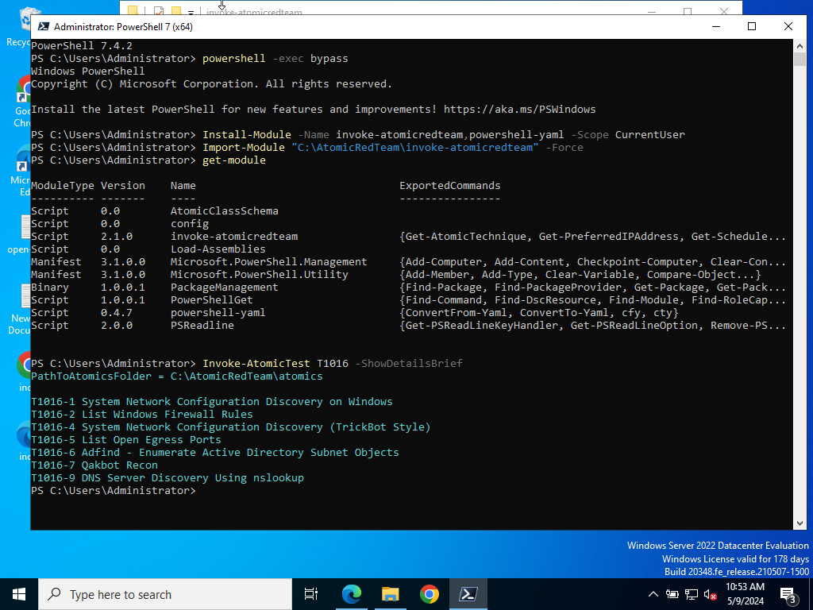
ATOMIC RED TEAM
T1016
We invoked T1016 to get details about the target operating system and configuration.
The Invoke-AtomicTest T1016 -ShowDetailsBrief
shows the list of attacks.
Using
Invoke-AtomicTest T﻿1016 -ShowDetails
will show more details about the technique
WIN2022

Slide 7
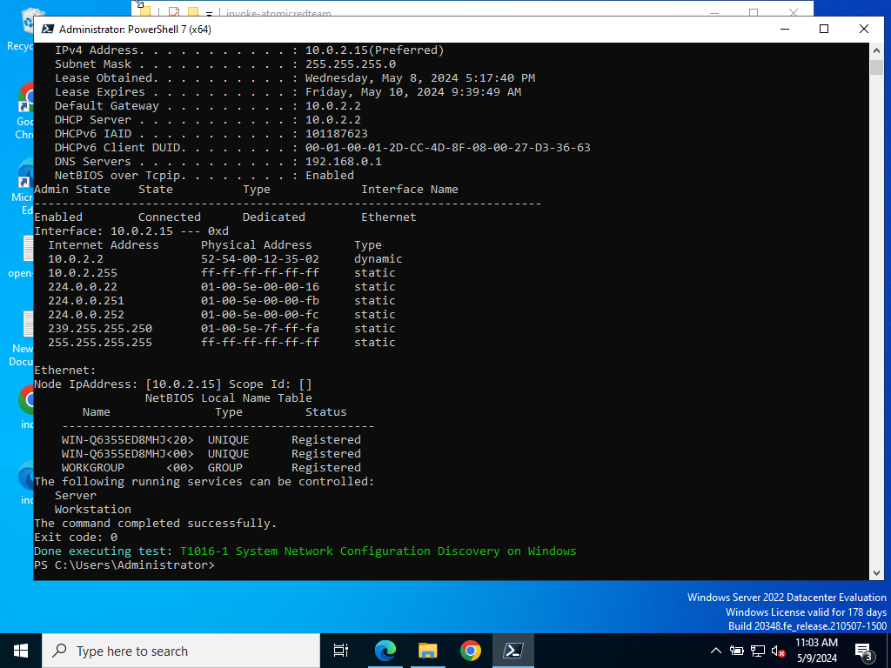
ATOMIC RED TEAM
T1016
We did attack 1
The attack result shows the IPv4 address and other necessary information about the OS
It also shows the physical address as well as other necessary information about the Admin
WIN2022

Slide 8
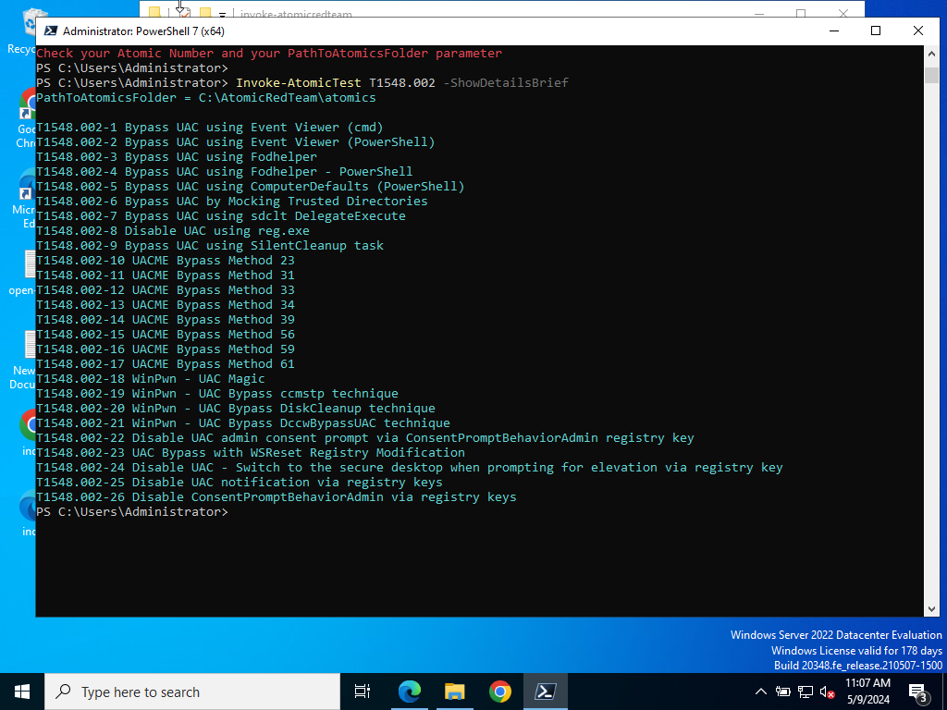
ATOMIC RED TEAM
T1548.002
We did more attacks, this attack is worth mentionable
T1548.002 is known as Abuse Elevation Control Mechanism
Upon investigating, we ran attack 1
WIN2022

Slide 9
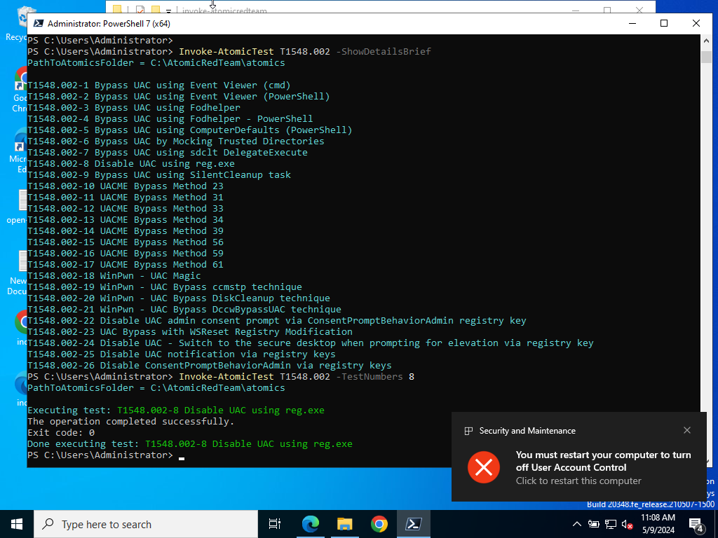
ATOMIC RED TEAM
T1548.002
Upon attack 1, it turned off the User Account Control. Upon restart the victim user will loose the account contol
WIN2022

Slide 10
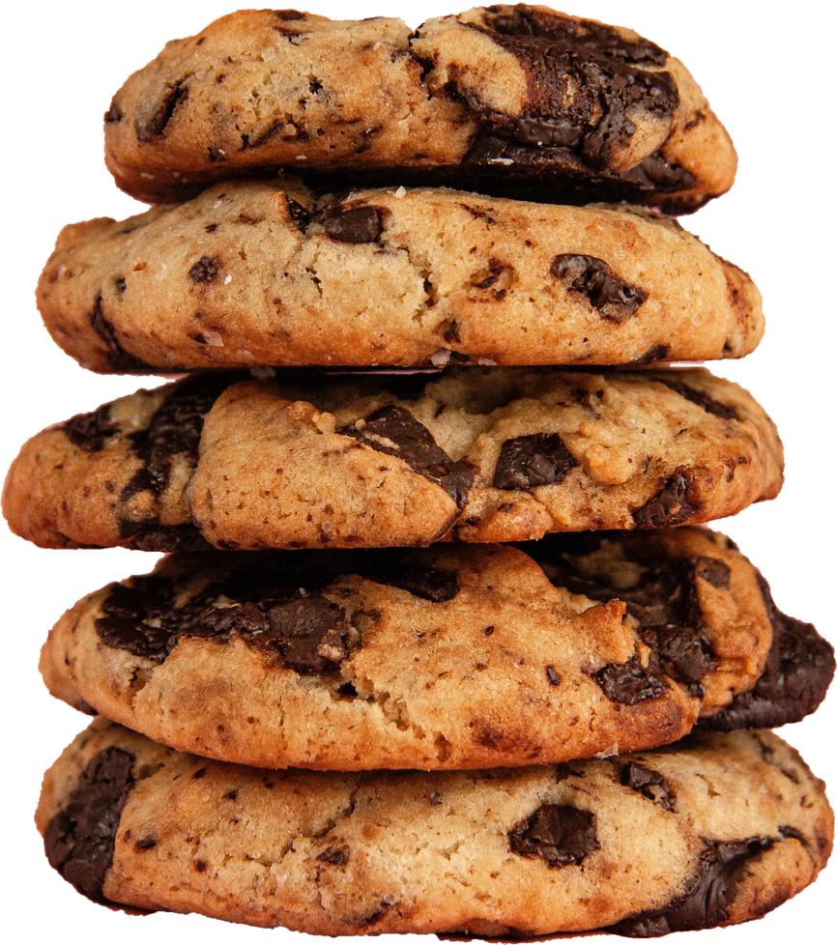
KALI LINUX
SCRIPT
From the Class and Video Class file available in the moodle, we learned to emulate attacks. We used severak scripts as the instructions guided.
We used the Damn Vulnerable Web Application (DVWA), to setup a controlled environment. The security setting was kept to low.

Slide 11
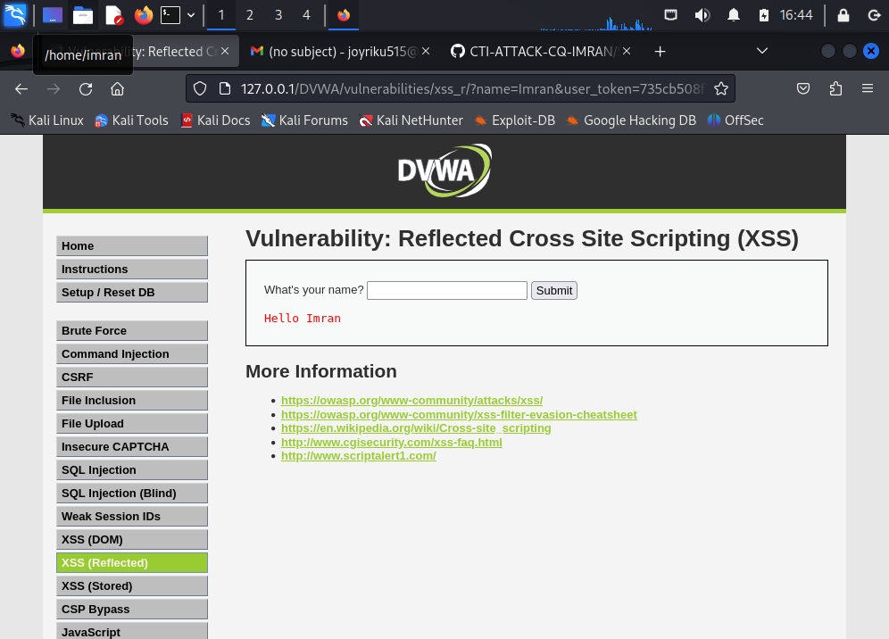
KALI LINUX
DVWA
To start with this, DVWA was setup per the instructions.
Setting was kept to low. We navigated to to the XSS(Reflected) to first try this

Slide 12
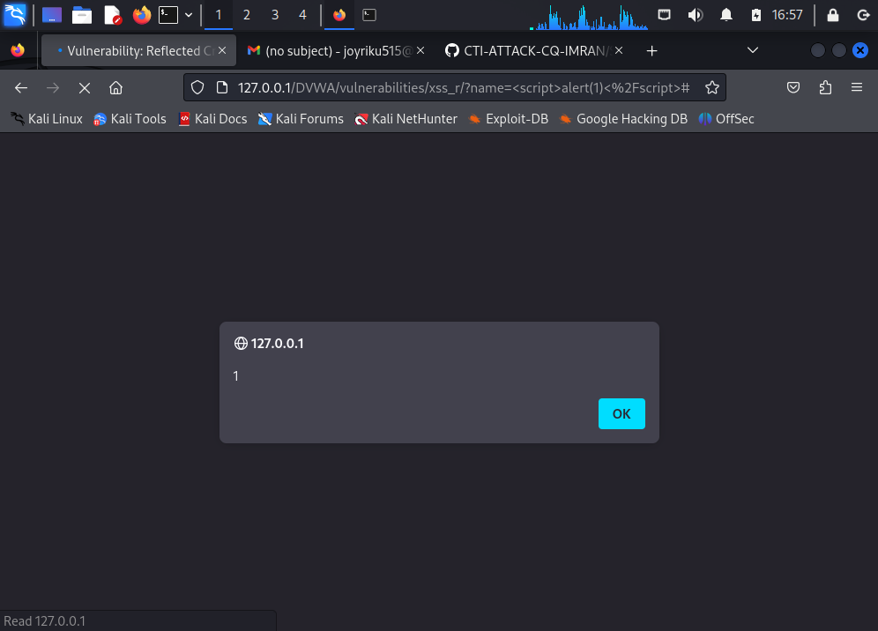
KALI LINUX
XSS
Alert.
For the first try, we used the script,
<script>alert(1)</script>
the browser displayed this alert after running it

Slide 13
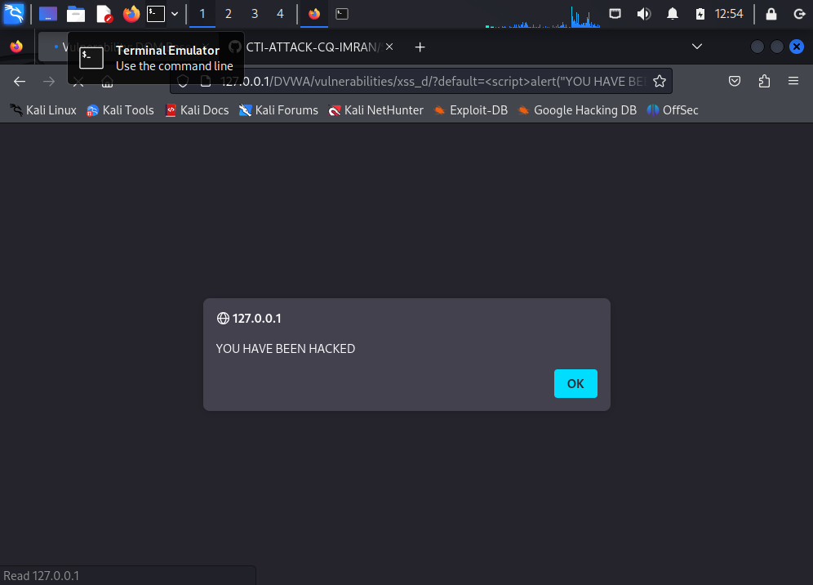
KALI LINUX
For Fun we did the message “You Have Been Hacked” message inside the alert box
<script>alert(“YOU HAVE BEEN HACKED”)</script>
the browser displayed this alert after running it

Slide 14
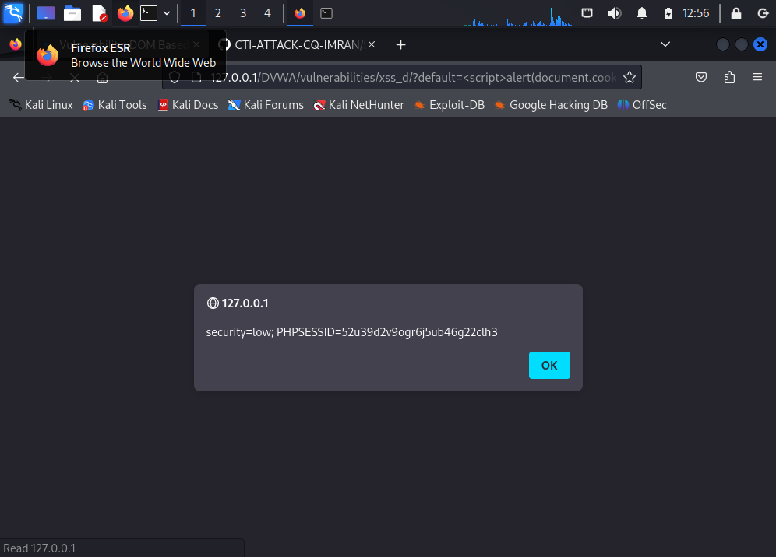
KALI LINUX
XSS DOM BASED
In the low security, we also edited the script again to steal cookies
<script>alert(document.cookies)</script>
the browser displayed this alert after running it. This will steal the document.cookie

Slide 15
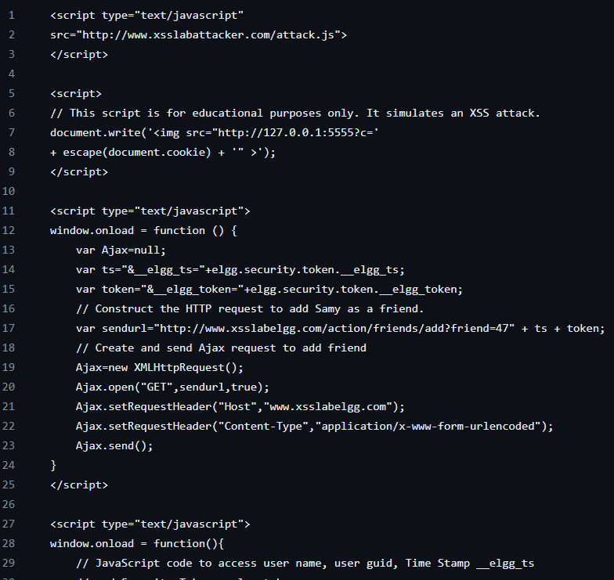
CUSTOM SCRIPT
We made a custom script that is inspired from PSI Squared. The script is available at the GitHub repository
This script loads an external Javascript file developed by PSI Squared. The file is available in the GitHub repository. The file is named attack.js from a remote server http://www.xsslabattacker.com/attack.js
The second of XSS Attack Simulation begins.

Slide 16
By simulating an XSS attack by generating a <img> tag with source URL http://127.0.0.1:5555 this incldues the encoded value of the victim‘s cookies . It send them to a speific endpoint which is http://127.0.0.1:5555.
The Third part of the script constructs an HTTP request to add a friend. http://www.xsslabelgg.com/action/friends/add?friend=47. It includes timestamp __elgg_ts and security token __elgg_token parameters obtained from the Elgg framework

Slide 17
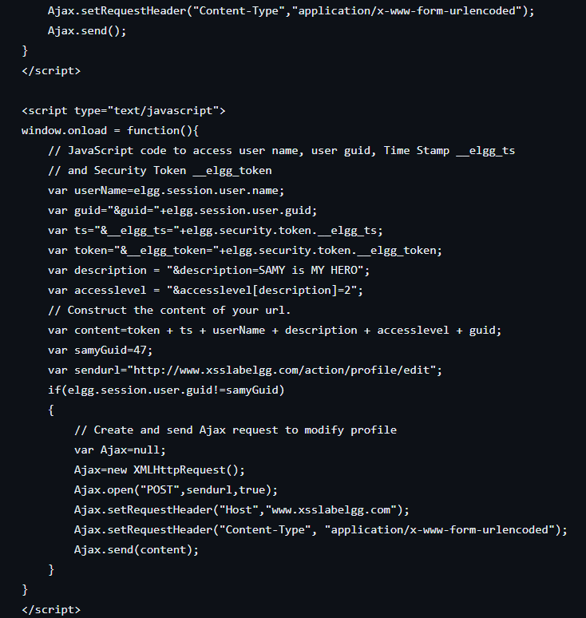
Lastly it does profile modification.
It constructs an HTTP POST request to edit the profile http://www.xsslabelgg.com/action/profile/edit with parameters such as username, timestamp, security token, description, and access level. The description is set to "SAMY is MY HERO". This action modifies the profile without the user's consent.

Slide 18
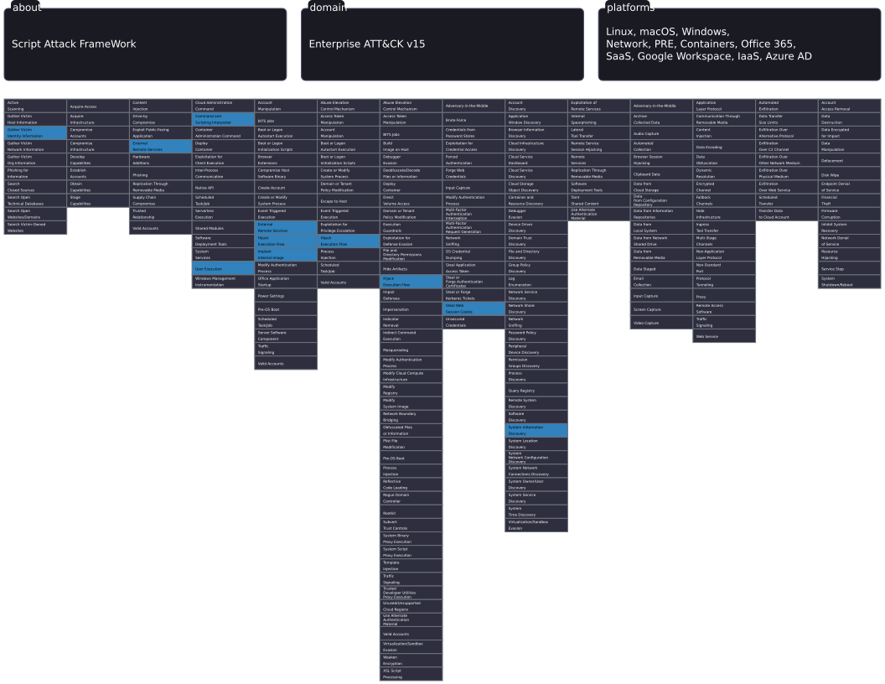
CUSTOM SCRIPT ATTACK NAVIGATOR
link of this navigator is present in the GitHub Repository

Slide 19
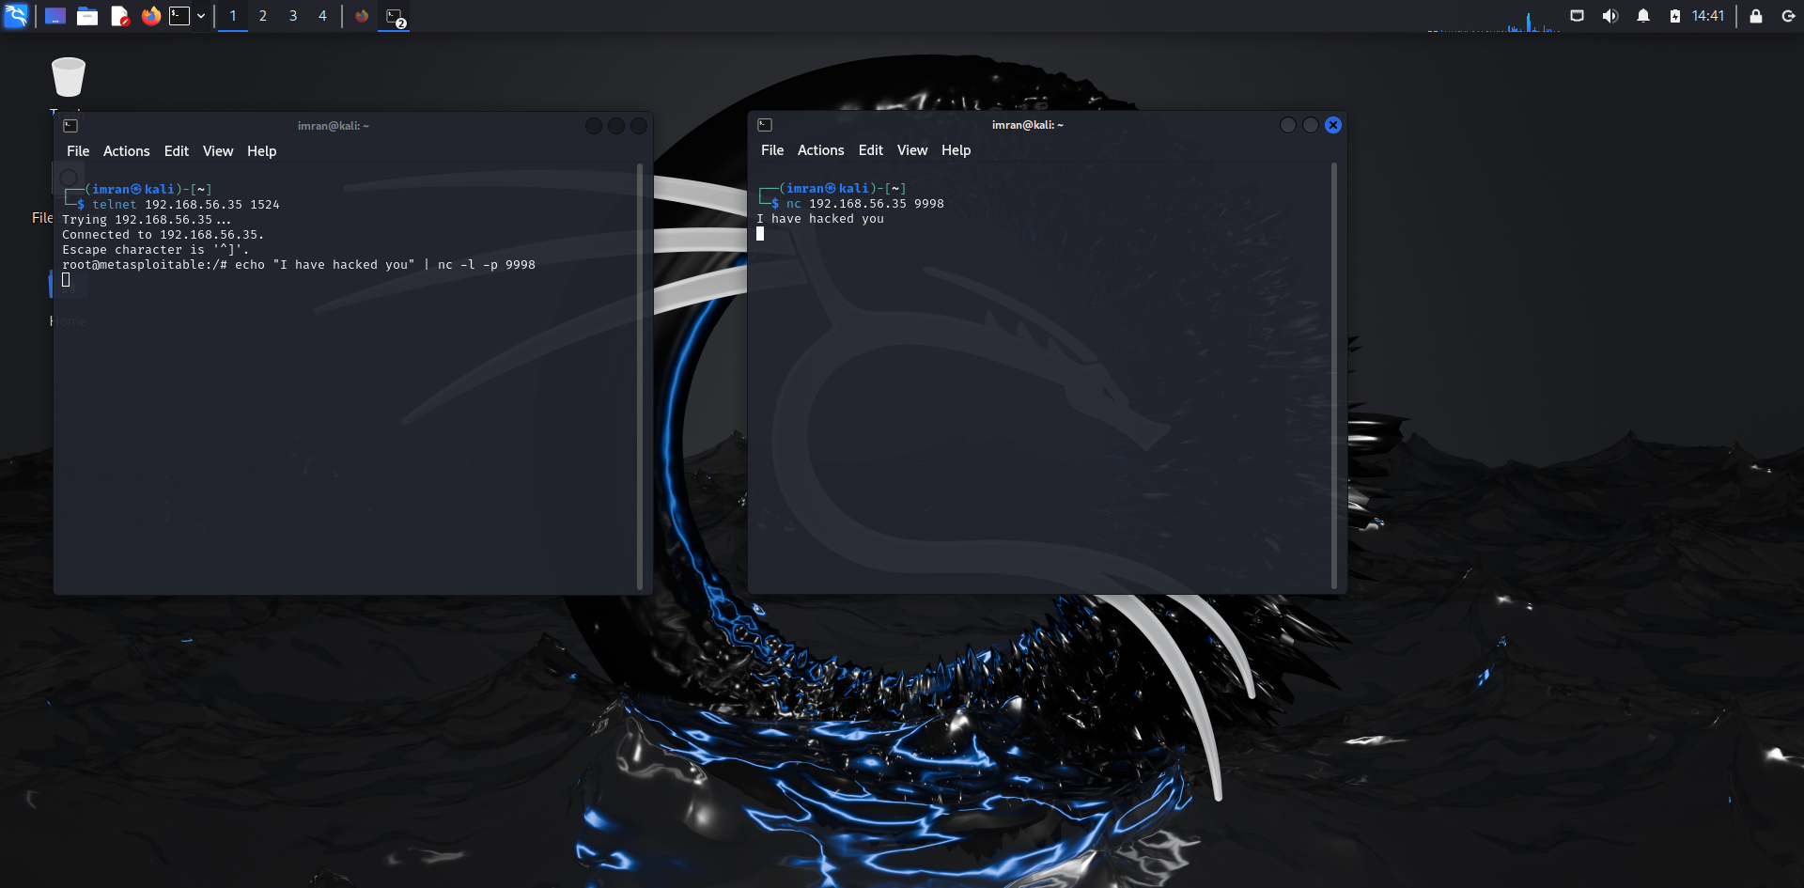
USING NETCAT TO LISTEN AND CONNECT
Using telnet 192.168.56.35 1524 we establish connection to ms2 metasploitable
Upon connection we displayed a message and put it on port 9998

Slide 20
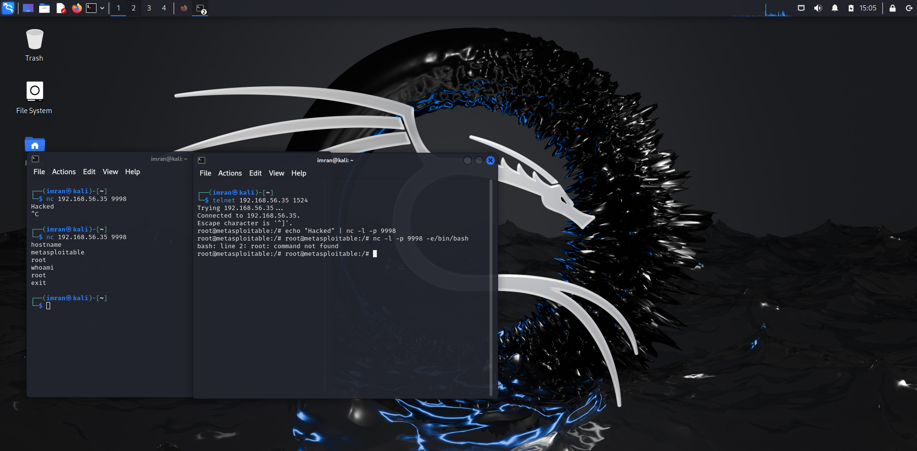
USING NETCAT TO LISTEN AND CONNECT
Further upon the connection establishment, we could aquire certain information based on commands like hostname, whoami

Slide 21

CONCLUSION
Throughout our presentation, we've traversed the intricate landscape of cybersecurity, exploring offensive tactics and defense strategies with diligence and curiosity.
https://github.com/richXardx/Portfolio-Attack-W9-.git
GitHub repository link for all the files

Slide 22
THANK YOU

